Slide 1

Bi-national Policy Forum on Migration and Global Health
October 3-4, 2011
San Antonio, Texas
Uninsured Latinos and the Affordable Care Act
Juan H. Flores
Executive Director
Notes:
INTRODUCTION: GIVE CONTEXT

Slide 2
Affordable Care Act Key Component
Access: Substantially Reduce Uninsured
Prevention: Promote & Shift Away from Acute Care
Quality: Best Practices, & Coordinate Patient-Centered Care
Drug Prescription Support for Seniors
Workforce Development
Accountability:· Regulatory Reforms Target Health Premium Increases, Transparency, Fraud & Other Abuses
Cultural Competency
Data Collection: Race/Ethnic & Gender
Notes:
MOVING PART & SOME INTENDED IMPACTS

Slide 3
Health Care Reform implementation Timeline
2010
Ending Pre-existing condition for kids
2010
Prescription Drug Discount
2010
Expand coverage for Early Retirees
Extend Dependent Coverage to Young Adults (up to 26)
High Risk Pool for uninsurable individuals w/ pre-existing conditions
Free Preventative Care for Seniors on Medicare
2010
Small Business Tax
Strengthen & Invest in Community Health Centers
Prohibit Rescinding coverage & lifetime bans
Regulating Annual Limits on Ins. Coverage
Payments to Rural Health Providers
Rebuilding Primary Care Workforce
Notes:
TIMELINES: LACK OF DATA MAKES IT DIFFICULT TO DETERMINE IMPACT ON LATINOS

Slide 4
Health Care Reform implementation Timeline
2011
Insurance must pay 80-85¢ of every $1 on medical services
2014
2014
Guaranteed Availability of Insurance
Medicare for Primary Care
Premium & Cost-Sharing Subsidies
2014
Expand Medicaid to 133% FPL
Teaching Health Centers
Health Exchange operating
No Annual Limits on Coverage
Can’t be denied for Pre-existing conditions
Individual & Employer Mandates
Notes:
EXPANSION OF MEDICAID & IMPLEMENTATION OF THE EXCHANGES IS THE MOST IMPORTANT COMPONENT OF THE ACA – OVERARCHING ISSUE = ACCESS TO HEALTH CARE

Slide 5
HEALTH CARE FOR LATINO FAMILIES & ACA
Seniors
Pre-existing Conditions
Young Adults
Prevention Focus [Delivery System & Programs]
Health Care Workforce
Small Business
Community Health Centers
Uninsured
  Medicaid Expansion
  Insurance Exchange
    Subsidies /Premium Credits: Individuals/Family
Notes:
ARE LATINOS BENEFITING? LACK OF DATA

Slide 6
ACA & HEALTH CARE INEQUITIES
The Affordable Care Act passed in March 2010 is intended to address current inequities in access to quality health care.
Inequity = differences in health which are not only unnecessary and unavoidable but, in addition, are considered unfair and unjust.
Equitable access to quality health care is essential to maintain good health because without it, opportunities to learn, work, earn a living wage and create wealth, and be a productive member of society is all diminished.
Health insurance is the key to gain access to health care.
Notes:
GROUND 0 TO BEGIN ADDRESSING INEQUITIES IN OUR HC SYSTEM!

Slide 7
UNINSURED IN AMERICA
The rate and number of unin­sured non-Hispanic Whites in 2010 were 11.7% (23.1 million), Blacks 20.8% (8.1 million), and Hispanics 30.7% (15.3 million).
Hispanic in the Southwest U.S./Mexico border states of California, Arizona, New Mexico, and Texas comprise 16% (8,214,570) of the total U.S. uninsured population and 54% of all Hispanic uninsured in the country.
Notes:
DO THE NUMBERS INCLUDING IMMIGRANTS

Slide 8
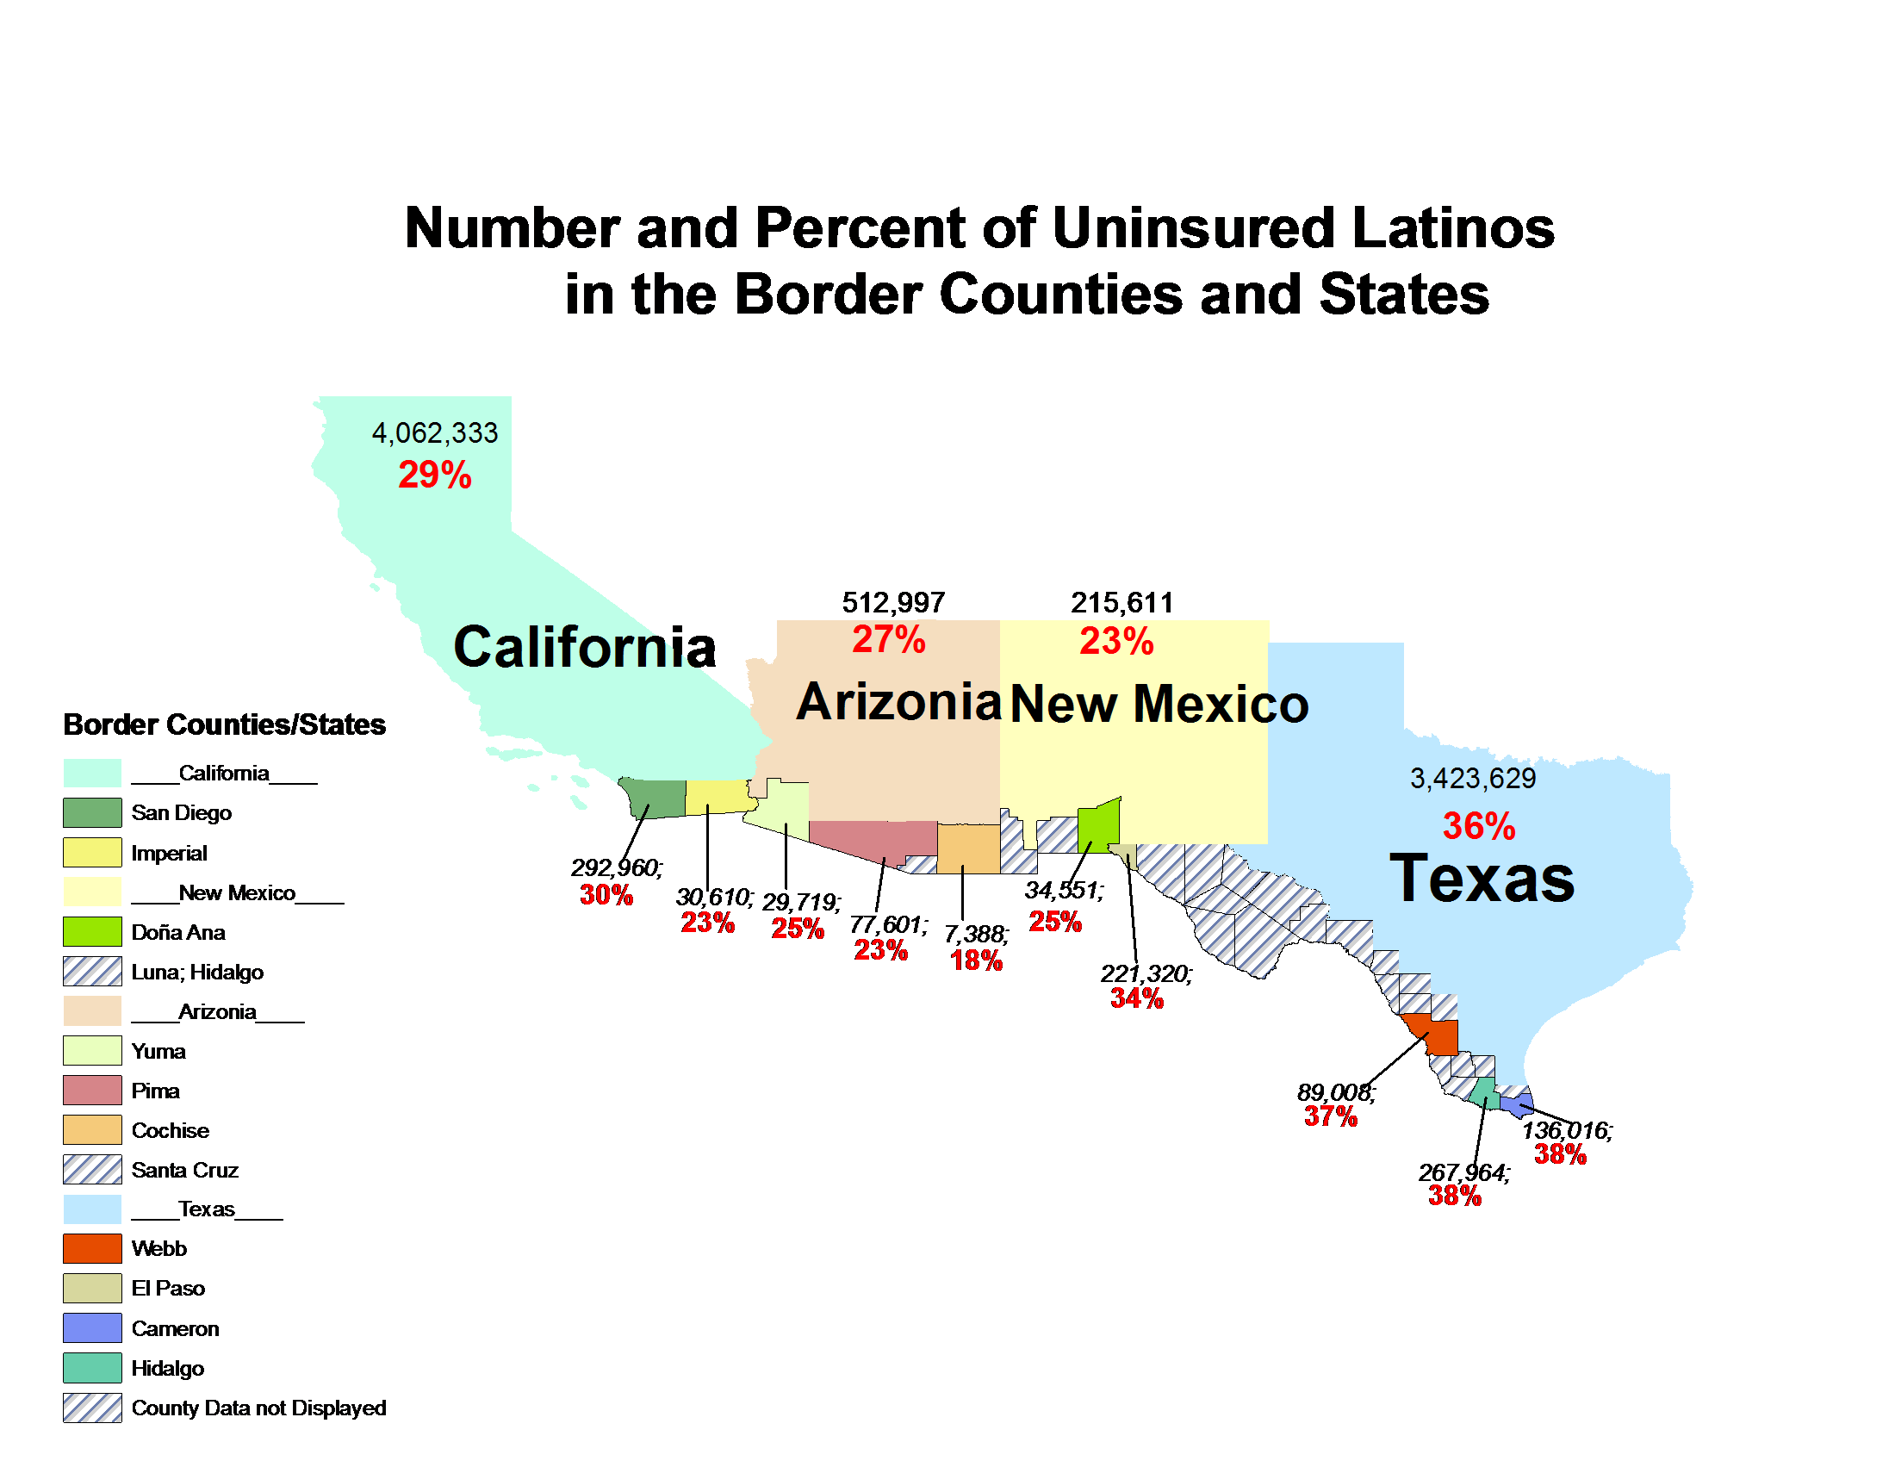

Slide 9
 |  | Totals |  | Health Insurance Coverage in 2010
 |  |  |  | Insured | Uninsured | PCT of Ethnicity | PCT of State Pop
CA | Totals | 36815569 | 100.00% | 29,990,656 | 6824913 | 18.54% | 100.00%
 | Non Hispanic | 22,884,031 | 62.16% | 20,121,451 | 2,762,580 | 12.07% | 40.48%
 | Hispanic | 13931538 | 37.84% | 9,869,205 | 4062333 | 29.16% | 59.52%
AZ | Totals | 6310174 | 100.00% | 5,245,042 | 1065132 | 16.88% | 100.00%
 | Non Hispanic | 4,438,017 | 70.33% | 3,885,882 | 552,135 | 12.44% | 51.84%
 | Hispanic | 1872157 | 29.67% | 1,359,160 | 512997 | 27.40% | 48.16%
NM | Totals | 2032699 | 100.00% | 1,634,141 | 398558 | 19.61% | 100.00%
 | Non Hispanic | 1,087,585 | 53.50% | 904,638 | 182,947 | 16.82% | 45.90%
 | Hispanic | 945114 | 46.50% | 729,503 | 215611 | 22.81% | 54.10%
TX | Totals | 24779450 | 100.00% | 18,903,976 | 5,875,474 | 23.71% | 100.00%
 | Non Hispanic | 15,380,369 | 62.07% | 12,928,524 | 2,451,845 | 15.94% | 41.73%
 | Hispanic | 9399081 | 37.93% | 5,975,452 | 3,423,629 | 36.43% | 58.27%
Notes:
REVIEW PERCENT OF TOTAL UNINSURE IN EACH STATE

Slide 10
ACA: How Many Latinos Will Be Insured
Depends On How Affordable
Affordability is increasingly challenged by the cumulative changes in health insurance premiums, inflation, and workers’ earnings.
Latinos represent the majority of all uninsured in the Southwest both among children & adults; uninsured at a rate more than twice that of Non-Latino Whites.
The education, employment and economic conditions of Latinos are much lower than Non-Latino Whites. What is affordable for Non-Latino Whites may not be affordable to the majority of Latino uninsured.
Notes:
WILL HEALTH INSURANCE BE AFFORDABLE EVEN WITH MEDICAID & EXCHANGES?

Slide 11

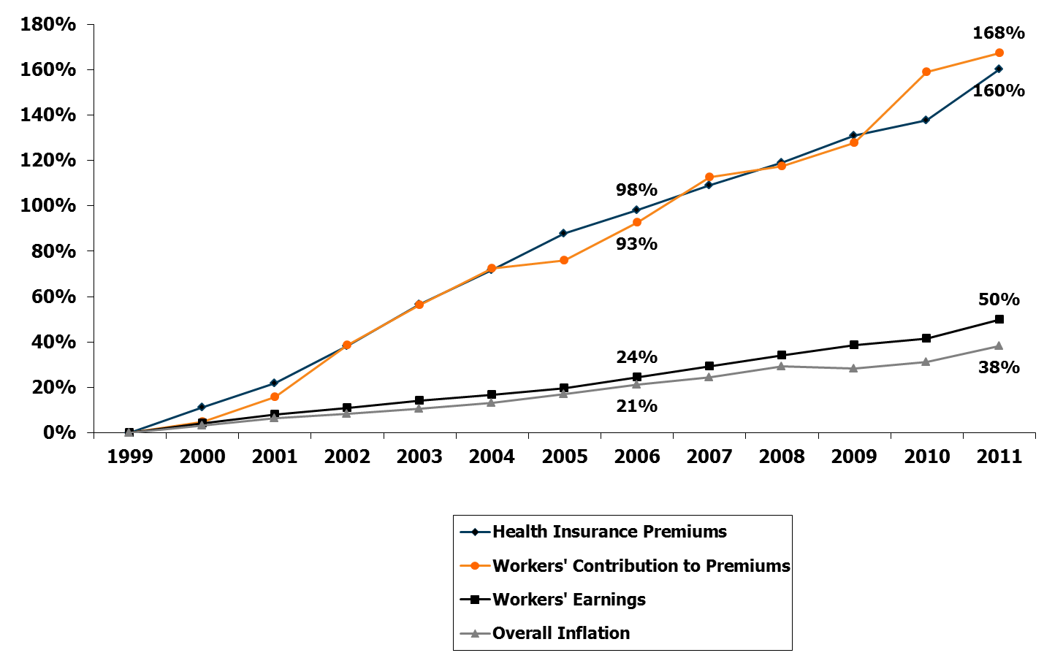
Cumulative Increases in Health Insurance Premiums, Workers’ Contributions to Premiums, Inflation, and Workers’ Earnings, 1999-2011
Source: Kaiser/HRET Survey of Employer-Sponsored Health Benefits, 1999-2011. Bureau of Labor Statistics, Consumer Price Index, U.S. City Average of Annual Inflation (April to April), 1999-2011; Bureau of Labor Statistics, Seasonally Adjusted Data from the Current Employment Statistics Survey, 1999-2011 (April to April).
Notes:
IMPLICATIONS FOR LATINOS – MORESO WITH RECESSION IMPACT!

Slide 12
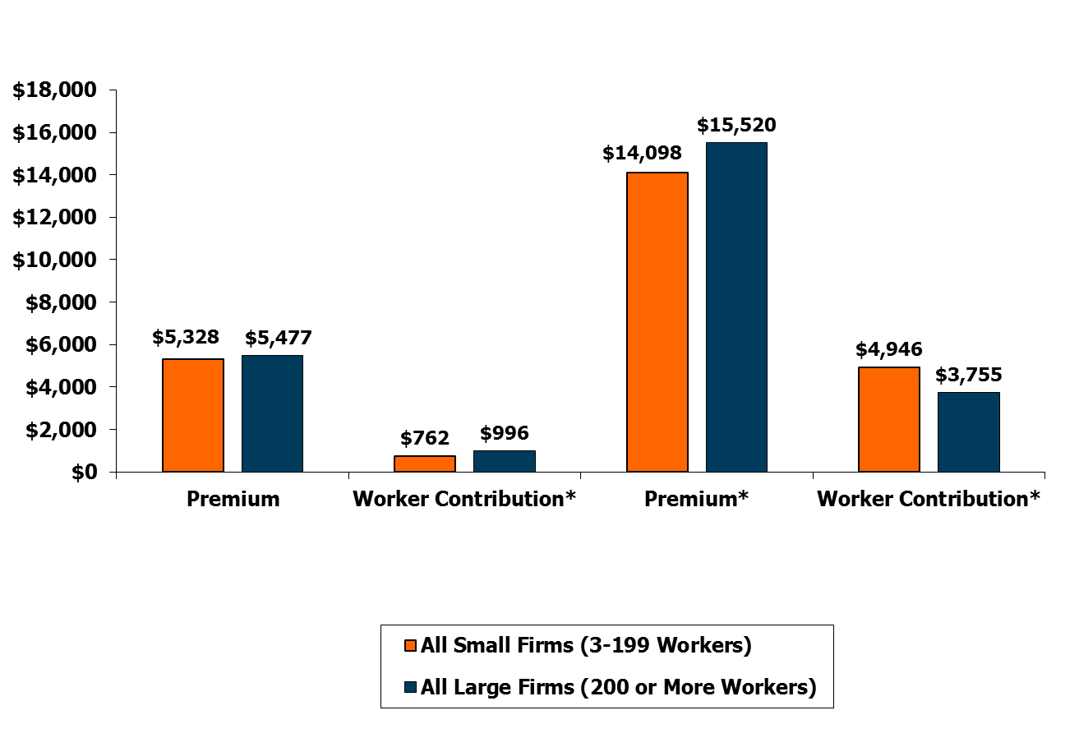
Average Annual Worker Premium Contributions and Total Premiums for Covered Workers, Single and Family Coverage, by Firm Size, 2011
Single Coverage
Family Coverage
* Estimates are statistically different between All Small Firms and All Large Firms (p<.05).
Source: Kaiser/HRET Survey of Employer-Sponsored Health Benefits, 2011.
Notes:
IMPLICATIONS FOR LATINOS CONTINUE

Slide 13
TEXAS: What is the number of individuals eligible for help under the new health reform law?
 | Eligible for Medicaid | Eligible for Subsidies | Total Eligible
Black | 329,100 | 260,100 | 589,200
Latino | 1,695,800 | 1,260,700 | 2,956,500
White | 952,400 | 1,000,200 | 1,952,600
Asian | 105,900 | 110,800 | 216,700
Native American & Alaska Native | 9,600 | 9,700 | 19,300
Native Hawaiian & Other Pacific Islander | 1,700 | 1,700 | 3,400
All Populations * | 3,094,500 | 2,643,300 | 5,737,800
Source: Families USA; * Numbers may not add up due to rounding

Slide 14
If you are a Working Family…
Individual Premium Credits
Affordable Care Act: Max premium contribution for Family of Four- Families USA
Premium credits to eligible individuals and families with incomes between 133-400% FPL to purchase insurance through the Exchanges. 62% of Texans will be eligible for Tax credit.
Up to 133% FPL: 2% of income
133-150% FPL: 3–4% of income
150-200% FPL: 4–6.3% of income
200-250% FPL: 6.3–8.05% of income
250-300% FPL: 8.05–9.5% of income
300-400% FPL: 9.5% of income
Income |  | Max Premium Contribution
% of Poverty | Dollars | Annual | Mnly
100% | $22,050 | $217 | $37
150% | $33,075 | $1,323 | $110
200% | $44,100 | $2778 | $232
250% | $55,125 | $4438 | $370
300% | $66,150 | $6284 | $524
350% | $77,175 | $7332 | $611
400% | $88,200 | $8379 | $698

Slide 15
Health insurance disparity for Latinos is particularly disturbing in that it persists when compared to Non-Latino Whites who are at the same level of education, whether they are employed or unemployed.
Texas Uninsured by Race/Ethnicity and Educational Attainment
Education | Texas | White | Latino | African American
No high school diploma | 42% | 22% | 36% | 28%
High school or equivalent | 30% | 19% | 41% | 36%
Some college, less than 4-yr degree | 20% | 13% | 29% | 23%
Bachelor's degree or higher | 9% | 5% | 16% | 15%
Source: US Census Bureau: Community Population Survey 2007
Notes:
CONSIDERATION FOR LATINO INSURANCE INEQUITIES, EMPLOYMENT & INCOME CHARACTERISTICS

Slide 16
Health insurance disparity for Latinos is particularly disturbing in that it persists when compared to Non-Latino Whites who are at the same level of education, whether they are employed or unemployed.
Texas Uninsured by Race/Ethnicity and Educational Attainment
(Percent of the total population within the same educational attainment)
Education | Texas | White | Latino | African American
No high school diploma | 46% | 15% | 75% | 7%
High school or equivalent | 26% | 29% | 51% | 14%
Some college, less than 4-yr degree | 19% | 34% | 43% | 16%
Bachelor's degree or higher | 9% | 44% | 31% | 11%
Source: US Census Bureau: Community Population Survey 2011
Notes:
CONSIDERATION FOR LATINO INSURANCE INEQUITIES, EMPLOYMENT & INCOME CHARACTERISTICS

Slide 17
Health insurance disparity for Latinos is particularly disturbing in that it persists when compared to Non-Latino Whites who are at the same level of education, whether they are employed or unemployed.
Texas Uninsured by Race/Ethnicity and Educational Attainment
(Percent of the total population)
Education | Texas | White | Latino | African American
No high school diploma | 46% | 7% | 35% | 3%
High school or equivalent | 26% | 7% | 13% | 4%
Some college, less than 4-yr degree | 19% | 6% | 8% | 3%
Bachelor's degree or higher | 9% | 4% | 3% | 1%
Source: US Census Bureau: Community Population Survey 2011
Notes:
CONSIDERATION FOR LATINO INSURANCE INEQUITIES, EMPLOYMENT & INCOME CHARACTERISTICS

Slide 18
Texas Labor Force Demographics
 | TX | White | Black | Hispanic
Management, professional, and related occupations ($54,828) | 33% | 42% | 28% | 18%
Service occupations ($21,821) | 17% | 12% | 21% | 23%
Sales and office occupations ($32,695) | 26% | 27% | 29% | 23%
Farming, fishing, and forestry occupations ($20,689) | 1% | 0% | 0% | 1%
Construction, extraction, maintenance, and repair occupations ($31,785) | 12% | 9% | 5% | 19%
Production, transportation, and material moving occupations ($31,634) | 12% | 9% | 16% | 17%
Source: American Community Survey, 2006-2008

Slide 19
Living, Poverty, and Minimum Wage
Hourly Wages | One Adult | One Adult, One Child | Two Adults | Two Adults, One Child | Two Adults, Two Children
Living Wage | $7.64 | $14.95 | $11.92 | $19.23 | $25.12
Poverty Wage | $5.04 | $6.68 | $6.49 | $7.81 | $9.83
Minimum Wage | $7.25 | $7.25 | $7.25 | $7.25 | $7.25
Annual Before Tax Income That's Required | $15,896 | $31,096 | $24,800 | $39,989 | $52,248
Source : Poverty in America, Living Wage Calculator: 2010

Slide 20
Texans Ratio of Income 2008
 | Texas | Hispanic | White | Black
Below 50% | 7% | 11% | 4% | 10%
50% to below 100% | 8% | 14% | 3% | 10%
100% to below 150% | 12% | 16% | 7% | 16%
150% to below 200% | 11% | 15% | 7% | 11%
200% to below 300% | 17% | 18% | 16% | 18%
300% to below 500% | 23% | 17% | 28% | 22%
500% and above | 22% | 9% | 35% | 13%
Source: Curent Population Survey, 2009

Slide 21
Additional Threats
Roll-Out of ACA Access & Other Components
Recession Impact on Latinos
Deficit Reduction Act
Super Committee Decisions
State Level Deficit Reductions
Overall Cuts Across Social Program: Across The Board
Anti-Immigrant Environment and Policy Impacts
Notes:
HIGHLIGHT EXAMPLE IN EACH AREA TO EXPLAIN/ELABORATE ON THREAT
NATIONAL & STATE LEVEL OPPOSITION TO ACA/COMPONENTS
COST OF LIVING & LESS MONEY FOR HC
CUTS & CHANGES TO MEDICAID
ACROSS THE BOARD CUTS PLUS MEDICAID, MEDICARE, ETC. CHANGES
SAFETY NETS AND SOCIAL DETERMINANT CUTS
WEDGE ISSUE FOR ALL THINGS GOOD

Slide 22
ACA & Determinants of Health
Among People of Color, advocates have known for over 30 years what researchers now call social determinates and their impact on the health and well-being of populations.
Equal access to education, job security, housing, and safety are examples of social determinates. Inequalities among these determinates contribute significantly to poor health.

Slide 23
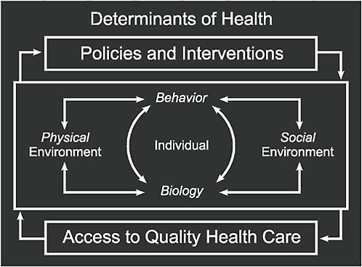

Slide 24
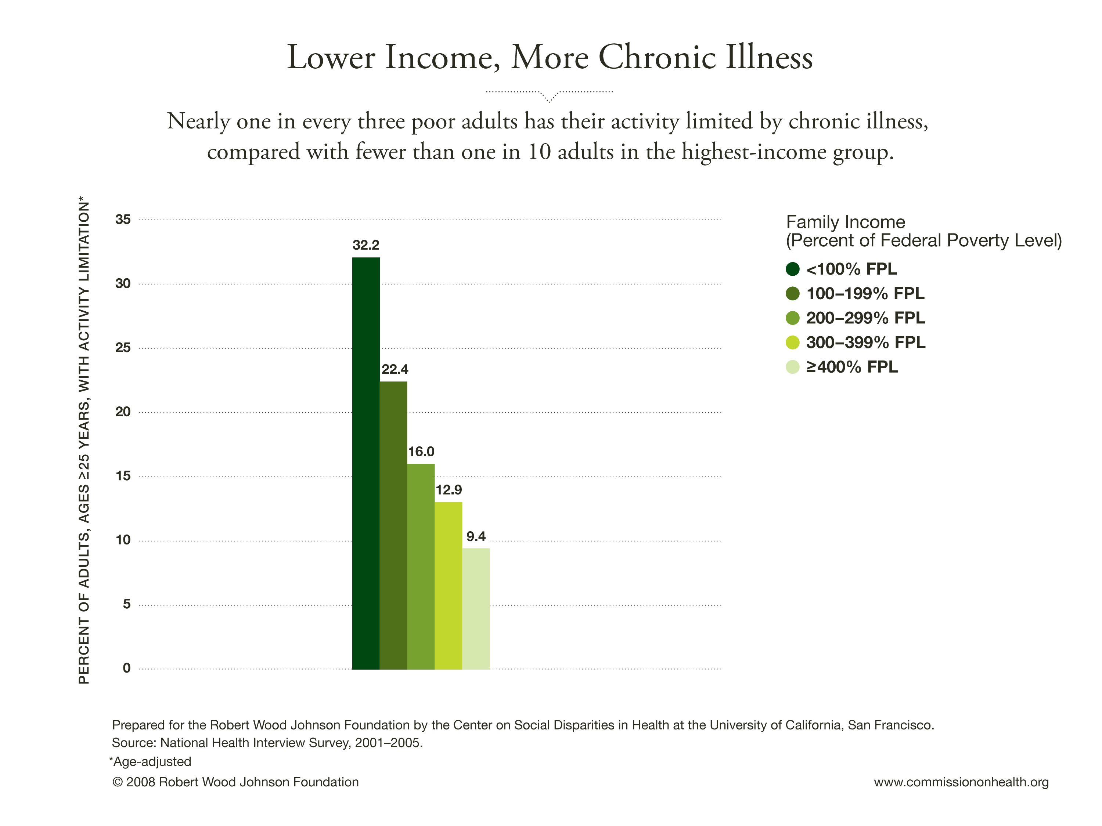

Slide 25
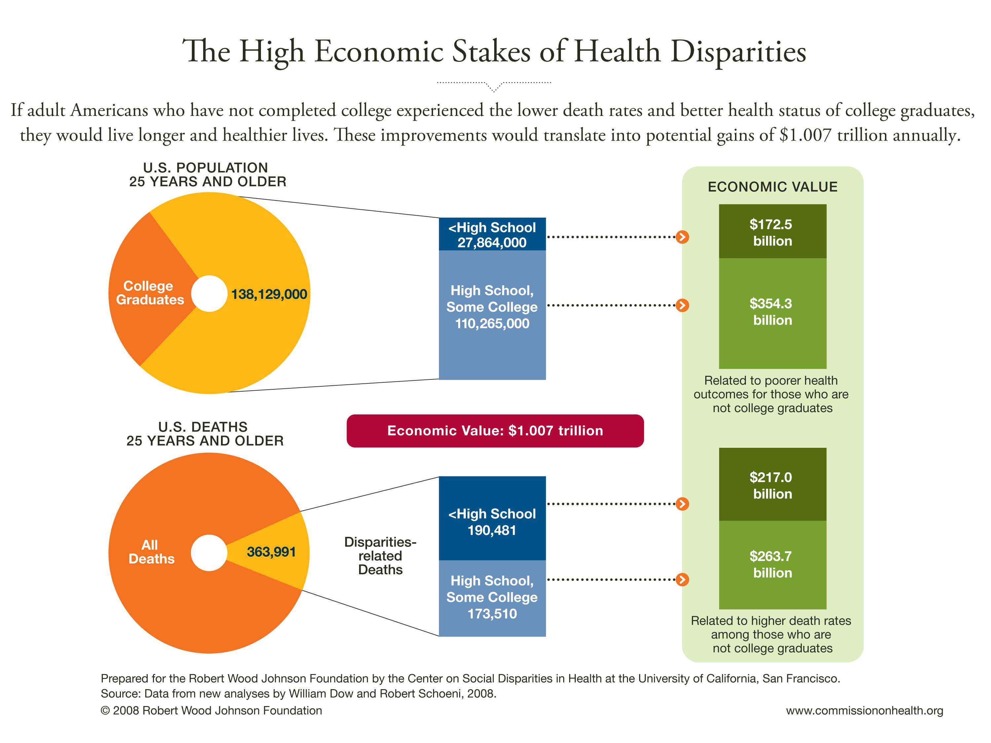

Slide 26
Ethnic Diversity of the Population, Householders, and Labor Force in 1990 and 2030*
1990 Population
1990 Householders
1990 Labor Force
2030 Population
2030 Householders
2030 Labor Force
* Projections are shown for the 1.0 scenario

Slide 27
TEXAS Health Status
Projection of the Prevalence of Diseases/Disorders for TX Children by Race/Ethnicity, 2000 & 2040*
The percent prevalence of diseases and disorders among all children age 18 and under will shift from Whites representing 49.1% and Latinos 34.7% in 2000 to Latinos representing 62.8% and Whites 23.6% of all diseases and disorders by 2040.

Slide 28
TEXAS: Health Status
The percent prevalence of diseases and disorders among all adults age 19 and above will shift from Whites representing 63.1% and Latinos 23.3% in 2000 to Latinos representing 51.4% and Whites 29.9% of all diseases and disorders by 2040

Slide 29
SUMMARY
The Federal Poverty Level (FPL), the measure of need for Medicaid and other social services, is an outdated inaccurate estimation of what it takes to live anywhere in the state and country (Center for Public Policy Priorities and Urban Institute).
Generally, it is a bare bones measure reflecting minimal financial sustainability.
We must continue to inform, educate and organize our community to advocate for effective Latino congruent in ACA implementation to reach the millions of uninsured and under-insured Latinos.

